Slide 1
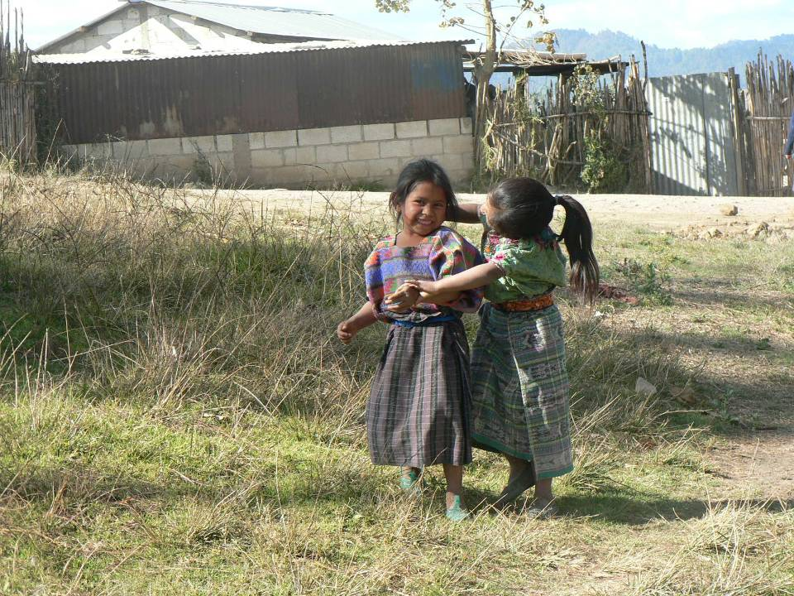
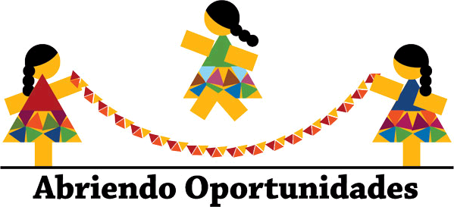
"
Guatemala's ‘Abriendo Opportunities' program"

Slide 2
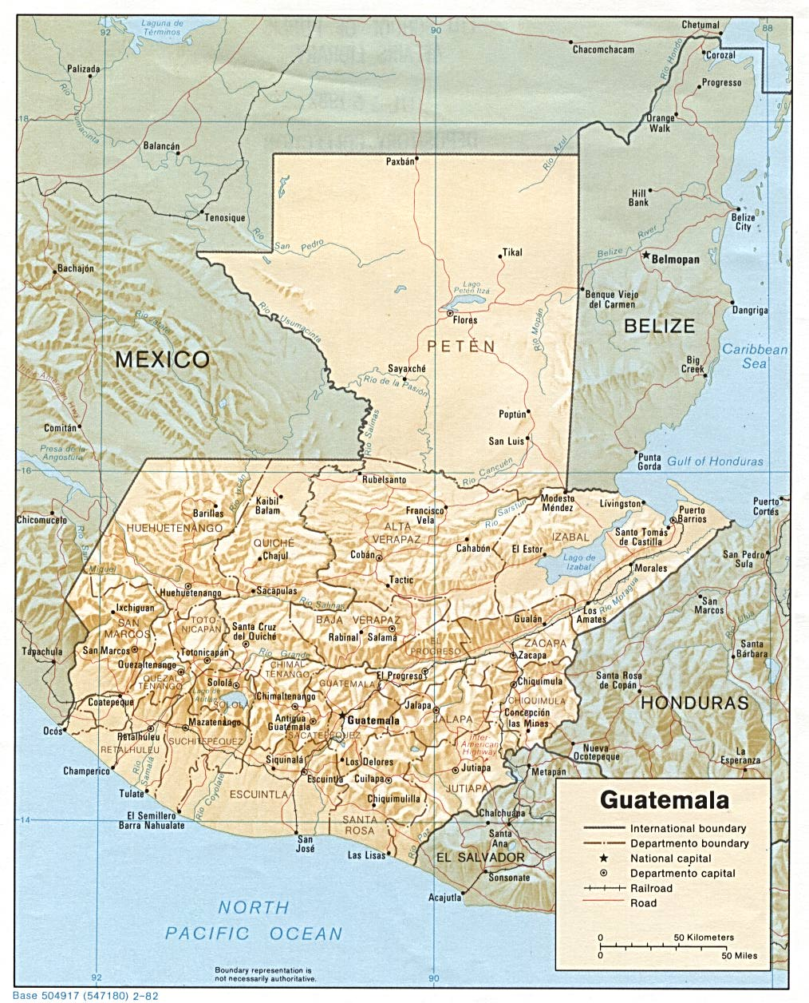
Guatemala
Population: 14 million
Growth rate: 2.5%
TFR: 4 births
IMR: 30 per 1,000 live births
MMR: 153 per 100,000 live births
Proportion urban: 39%
Proportion under age 30: 69%
Proportion indigenous: 38%
23 different languages
Live below poverty line: 75%
Notes:
Guatemala is a country of deep contrasts. It is among the top ten countries in the world with the widest gap between the rich and poor. It ranks among the top 10 exporters of sugar and coffee beans in the world (http://www.suite101.com/content/top-ten-sugar-exporters-a24351), a great feat considering that the country is only 109,000 km2. While Guatemala City is the largest city in Central America, Guatemala is also the country in the region with the highest percentage of rural population AND the country with the largest percentage of indigenous population in Central America and, along with Bolivia and Ecuador in South America, the countries with highest % of indigenous populations in the continent. Guatemala is a country of 14 million people where over 20 languages are spoken in an area that is the size of Bulgaria and with a density of 119 people per km2. the TFR is the highest in Latin America and comparable to that of LDCs (4.2-2.9 rural-urban; 4.5-3.1 indigenous-non indigenous). IMR ranks 146 of 224. MMR: A good proportion of this area is mountainous and prone to environmental threats. According to the Conference of Parties on Climate Change 2010, Guatemala also ranks among the top ten countries in the world most vulnerable to the effects of climate change, and it is the first among Latin America. If we add to all of this the effects of a 30 year civil war, we find ourselves with a country with great need but also great potential in its human and natural resources, in its ancient culture and lessons in human resilience. After this brief context, I will proceed to present Population Council’s work with indigenous girls and adolescents in Guatemala.
While current laws do not discriminate between men and women, indigenous and non-indigenous Guatemalans, many historical, geographical and economic factors limit women’s, and particularly, young women’s and girls, access to services and rights. For example: while loans to purchase land are available to all, most property still belongs to men, and there is a disproportionately high percentage of women who farm land that does not belong to them. Women work in the informal sector. Data from INE, 2008 “Mujeres y hombres en cifras”
Legal services are seldom in Maya languages. Legal services located in urban areas (high cost of transportation, often without basic documents like birth certificates, IDs) Positive change: more women registered to vote in 2011 than men.

Slide 3
What is the situation of a 12-year-old rural indigenous girl?
Around puberty, indigenous females tend to be withdrawn from the social sphere
At this stage, the paths of girls and boys diverge: boys lives continue to open and girls lives contract
  Young females begin to experience social isolation
Restricting young girls from social services and opportunities contributes to chronic cycles of intergenerational poverty and poor health in the poorest communities

Slide 4
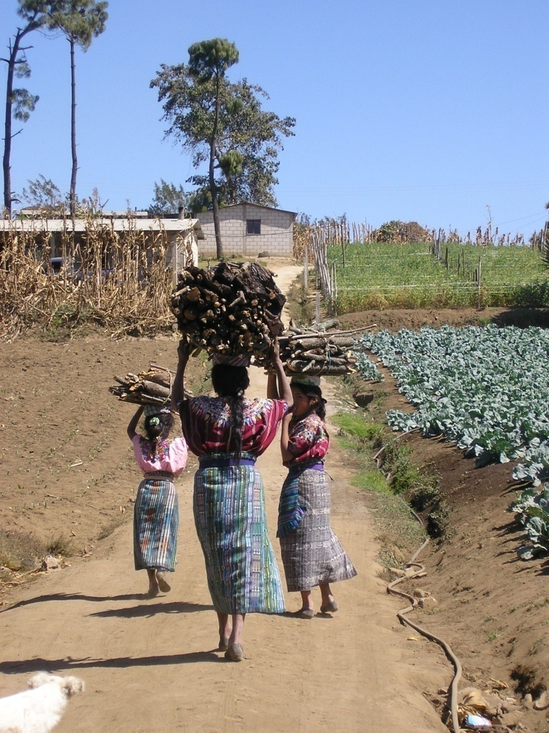
The lives of rural indigenous girls
Early school dropout
  Limited opportunities to build vocational and productive skills
  Inexistence of social and recreational activities
Heavy domestic and productive work burden
Limited mobility and autonomy
  Reduced access to information and social services
  Decreased peer and social networks
Increase in risk of social and gender violence
Early marriage
  Early and repeated pregnancies

Slide 5
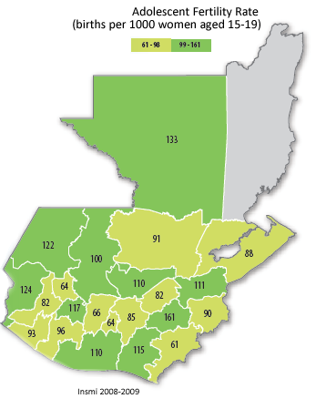
Adolescent fertility rate
Adolescent fertility rates
births per 1000 women aged 15-19
URBAN
78
RURAL
114

Slide 6
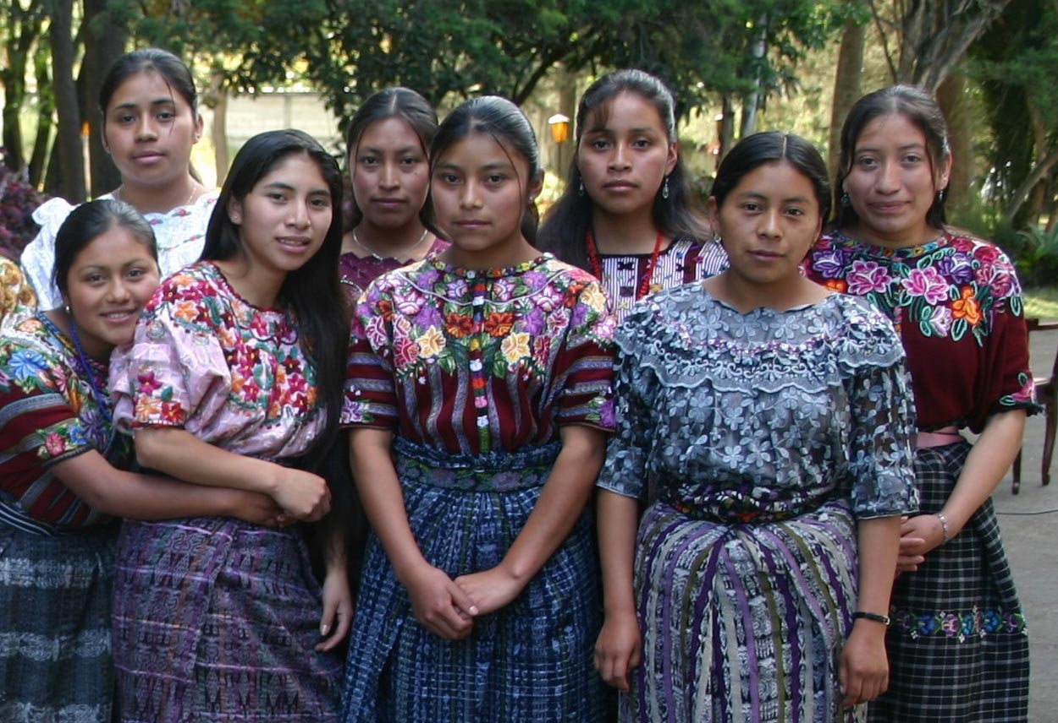
Abriendo Oportunidades program pilot phase
Youth program inventory and subsequent Coverage Exercise revealed limited attention to Mayan girls
  Nothing to build on
Pilot designed and tested 2004-2006
Collaboration with rural communities and local NGOs

Slide 7
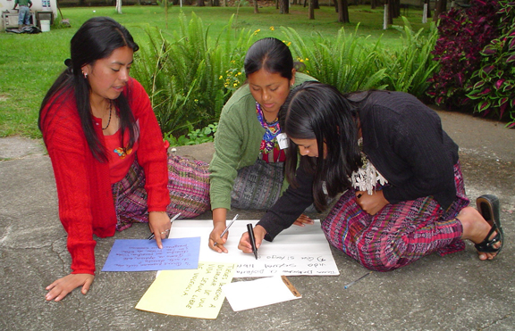
Goals of program
Build girls’ social health and economic assets
Create inclusive safe public space for girls in communities
Strengthen peer networks
Provide access to
alternative role models
and life paths
Offer opportunities for
learning, recreation
and social interaction
Promote girls’ education,
health, and well-being at
the community level
Notes:
To stay or return to school
To delay first union/marriage
To delay first pregnancy until at least 20 years of age
To prevent community level gender based violence
To increase girls’ and adolescents’ self-esteem, decision making and negotiation tools, and over-all visibility in their communities.

Slide 8
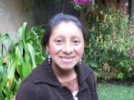

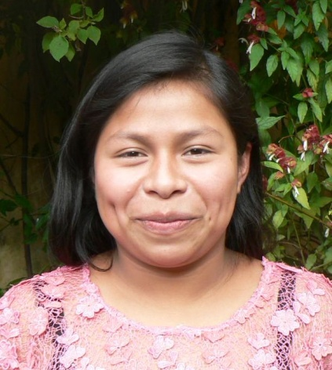
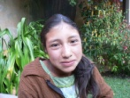

Strategy: participation is key
Cascading leadership approach
Young female adolescents ages 15–20 recruited and trained to become leaders:
  Some undertake professional internship (with stipend) in local institutions
  All lead community girls’ groups with girls 8-12 and 13-18
Continuous training and mentorship process

Slide 9
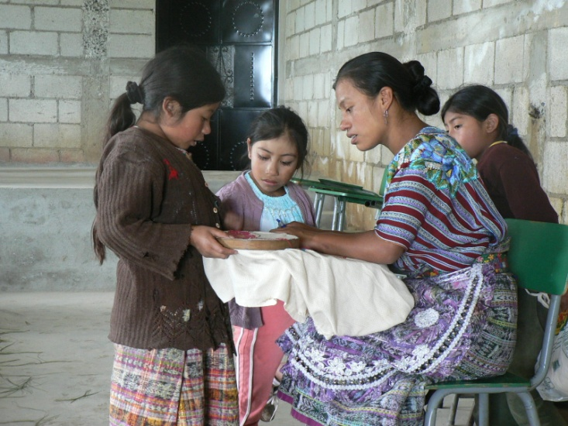
Program design: addressing the gaps
Geographic focus
To go where no other
projects are going
Ethnicity and language
Mentors speak the
local language and
understand
their culture
Peer to peer
To cover the age sectors
with greater unmet
demands through peer
education methodology

Slide 10
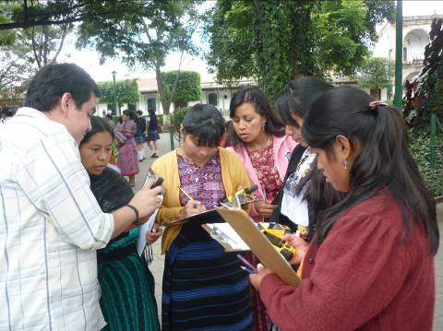
Program design: adapting to meet needs
Use of technology
Use of GPS to improve
knowledge
of communities,
safe spaces, threats
Graduates taking the lead
Mentors and graduates
involved in research design,
M&E and training
Expanding the network
Connecting to services,
local governments, sharing
the model

Slide 11
Expected changes at level of girl
Assets provided through program
Indicators of impact
Girls’ and their needs more visible and “unavoidable”
More friends and mentors
Increased self-esteem
More ambitious educational, employment and citizenship goals
Desire for later marriage and smaller family
Greater autonomy and mobility
Increased financial knowledge and skills
Safe public space for girls in community
Larger and stronger peer network
Access to positive role models and mentors and peer
Opportunity to learn new knowledge and skills
Life plan
Promoting registration in civil records through identity card
Stipend and bank account (girl leaders)
Notes:
“Unavoidable” : girls become facilitators of development. Through the platform, other resources reach the community. Leaders acknolwedge girls’ importance, renew their access to space, encourage participation.

Slide 12
The program beyond the girl
Call to Action: Mobilize and empower rural girls to improve health, foster leadership and contribute to personal, community and national development
Support and promote girls’ health, well-being, and social participation. Improve SRH and increase autonomy, life skills, education, and livelihood options
Create mechanisms for girls’ voices to be heard and needs met at the family, community and national levels
Institutions:
Civil Society, Public Sector, Private Sector, Donors
Nation
Community
Family
Relationship
Individual
Individual
Goals:
Reorient policies and budgets to respond to poorest, most vulnerable youth needs
Develop youth to represent themselves and claim entitlements
Goals:
Target most vulnerable by age, sex, marital status etc.
Build youth assets and capabilities
Expand youth control over resources
Goals:
Train and support providers of youth programs and services
Integrate agendas with constituent groups
Raise awareness and visibility across sectors
Mobilize support and multi-sector partnerships
Goals:
Orient and engage key leaders
Create enabling environment for youth participation
Create safe spaces for girls
Create positive changes in social norms
Goals:
Skills building/ couples communication
Form positive gender norms
Goals:
Engage parents, in-laws, and others
Create supportive family environment
Notes:
12
In the next 10 years, more than 100 million girls in the developing world will marry before 18. Data has illustrated that marriage will change virtually everything in a girl’s life, including with whom she associates, where she lives, what happens to her body and her sexuality. Data from the Population Council has also shown that young married women have less mobility than unmarried girls & older married women, Less decision-making power in the household than older married women, less exposure to media than unmarried and older married women, more limited social networks than unmarried girls and older married women, and may be at greater risk for gender based violence. Given that all of these social factors exacerbate negative RH outcomes for young married, and the fact that there are limited reproductive health programs geared towards meeting the needs of young married individuals, the ACQUIRE Project launched an initiative to focus on young married.
The initiative has three main objectives: to increase YM couples’ knowledge about RH issues, to create a supportive environment within service delivery sites to enable YM couples to access services; and to create an enabling environment within families and communities to enable married youth to access RH information and services.

Slide 13
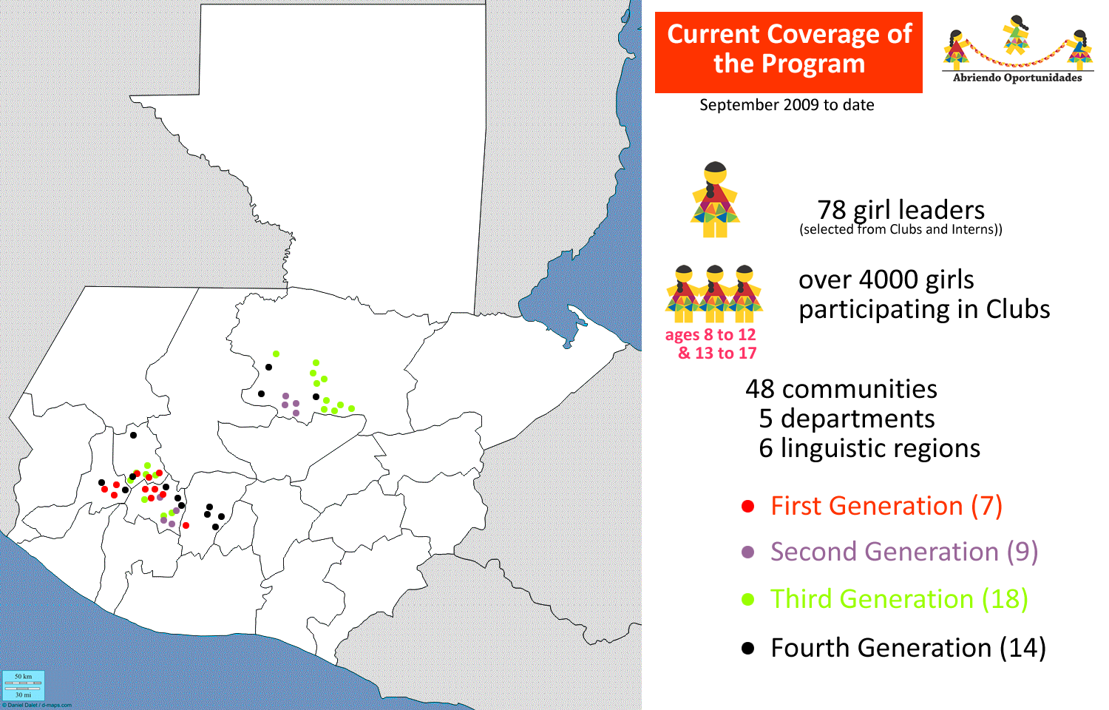

Slide 14
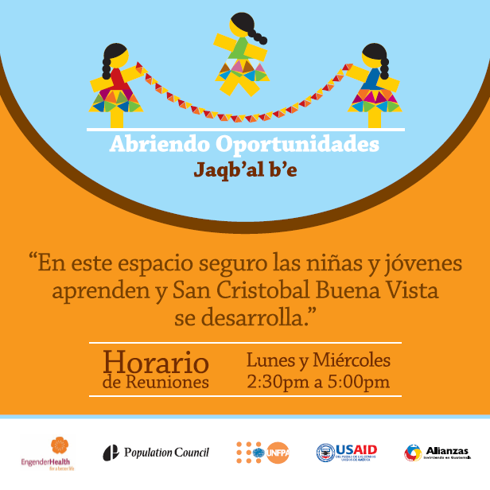
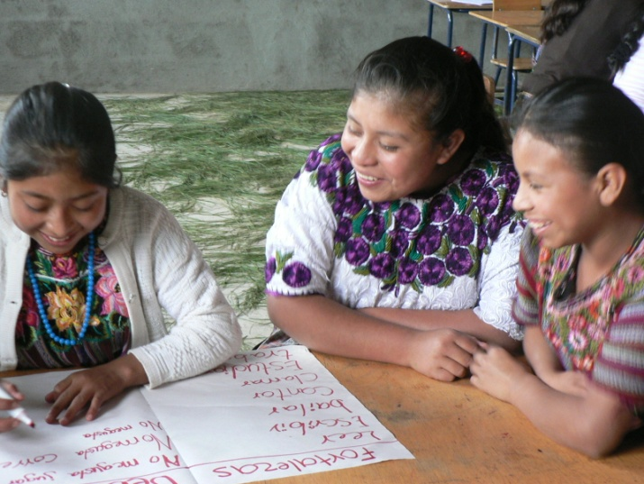
Challenges 2011-2014
Establish measures for success, participatorily
Export and share methodology based on “certification” approach
Expand mechanisms for fund-raising
Expand network for job opportunities, scholarships and training
Abriendo Oportunidades becomes a national organization led by young Maya women

Slide 15
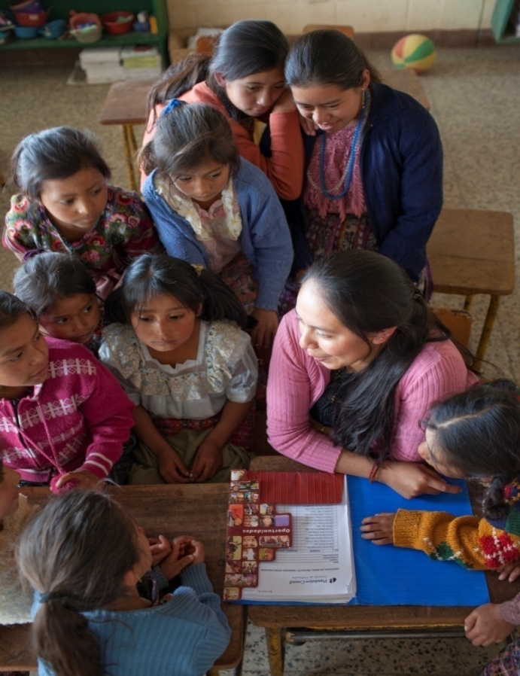
Useful lessons for other programs
Methodology: coverage exercises, identifying vulnerable populations and costs.
Program design: applied research as base, engagement of participants, adaptation to local cultures
Networking and maximizing local resources: engaging leaders, creating partnerships, girl networks
Monitoring and evaluation: simple strategies adapted to local contexts
Adaptation to context: working under difficult logistic and social conditions
Notes:
Reaching distant communities is expensive. Local traditional leaders often require lengthier consultation processes than more urbanized-westernized leaders. Vulnerability is real: one on one investment pays off (conflict management, engaging reluctant leaders or parents, case-specific intervention).

Slide 16
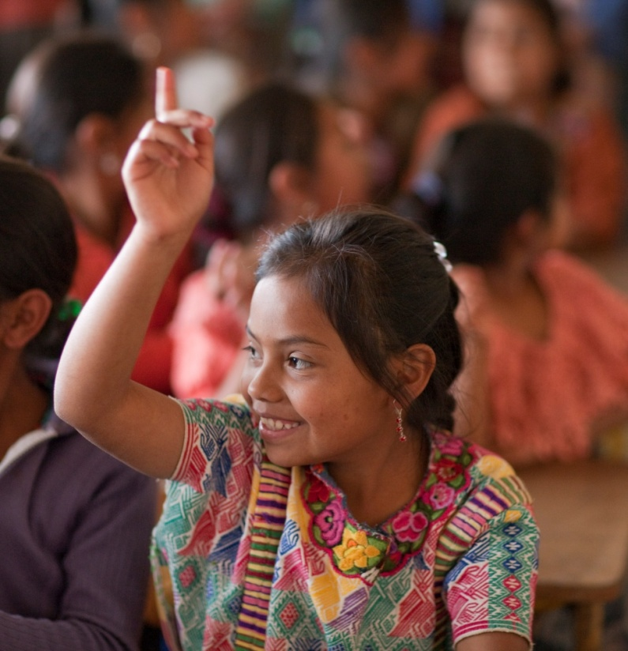
Questions or comments?
Thank you!
Bantiox Aawe’!

